Slide 1
DROWSINESS DETECTION SYSTEM WITH ADVANCED FACE TRACKING
Uttej Orra

Slide 2
Introduction
Each year, 800 fatalities and 50,000 injuries result from drowsy-driving incidents, underscoring the critical need for effective fatigue detection measures.
Our project introduces a cutting-edge Drowsiness Detection System that integrates face tracking, real-time facial feature monitoring, and the innovative Eyes Aspect Ratio (EAR) parameter.
Using machine learning, our system continuously refines its fatigue detection capabilities, ensuring precise analysis of eye movements and facial expressions indicative of weariness.
Beyond road safety, our technology addresses the risks faced by industrial workers, redefining workplace security through advanced computer vision and real-time monitoring.
The system utilizes computer vision techniques to detect facial landmarks, analyzing eye movements, eyelid patterns, and facial expressions. It quantifies fatigue using the Eyes Aspect Ratio (EAR) parameter, providing a quantitative metric for assessment.

Slide 3
Literature Survey
1.A Review of Recent Developments in Driver Drowsiness Detection Systems
Yaman Albadawi, Maen Takruri, Mohammed Awad:
This study by Yaman Albadawi, Maen Takruri, and Mohammed Awad extensively investigates the development and applications of driver drowsiness detection systems over the last decade. It categorizes these systems into image-based, biological-based, vehicle-based, or hybrid-based, detailing their features, classification algorithms, and datasets. The study emphasizes the challenge of quantifying the extent of drowsy driving's impact on attention and alertness levels, offering a comparative analysis of system types and outlining future trends. It serves as a valuable resource for enhancing road safety.

Slide 4
2. A review of physiological signals based driver drowsiness detection systems.
Adil Ali Saleem, Hafeez Ur Rehman Siddiqui, Muhammad Amjad Raza, Furqan Rustam:
This comprehensive survey by Adil Ali Saleem, Hafeez Ur Rehman Siddiqui, Muhammad Amjad Raza, and Furqan Rustam delves into driver drowsiness detection techniques, focusing on the use of physiological signals. It highlights the prevalence of drowsy driving incidents, particularly among young drivers and night shift workers, emphasizing the need for a comprehensive approach integrating various measures. The survey scrutinizes sensor nuances, environmental considerations, and experimental setups, offering guidance for stakeholders and advocating for advancements to reduce accidents, injuries, and fatalities associated with drowsy driving.

Slide 5
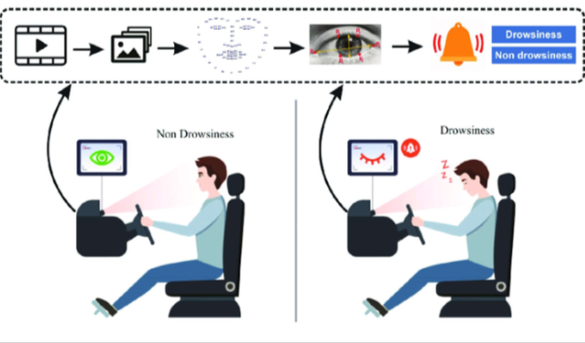
DESIGN PHASE
The proposed drowsiness detection systems take images or videos as input, utilizing OpenCV for facial landmark detection and the dlib library for facial feature tracking. These technologies analyze eye movements and expressions to calculate the Eyes Aspect Ratio (EAR), a key metric for fatigue assessment. The systems integrate auditory alerts using pygame and winsound libraries and provide real-time visualization for immediate user feedback.

Slide 6
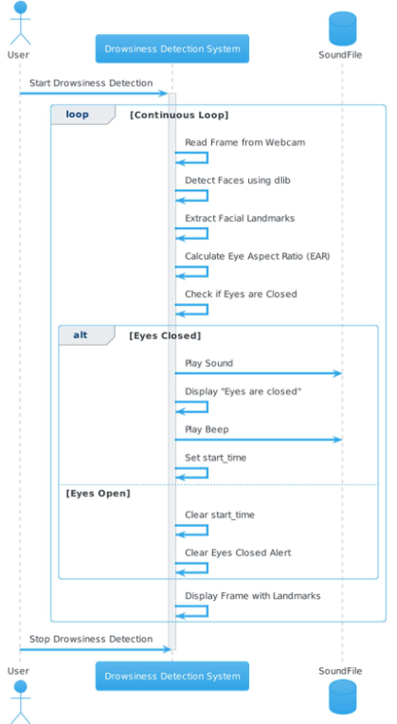
Sequence Diagram

Slide 7
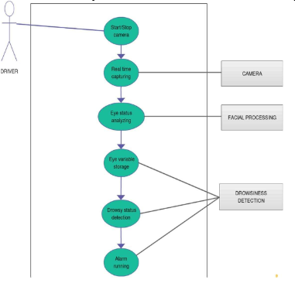
Use Case Diagram

Slide 8
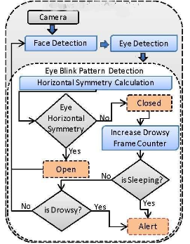
Data Flow diagram

Slide 9
Conclusion
In conclusion, our project represents a significant advancement in drowsiness detection systems, leveraging cutting-edge technologies to enhance road safety and workplace security. By integrating OpenCV and the dlib library, our system offers a cost-effective and adaptable solution for real-time fatigue assessment. The incorporation of auditory alerts and real-time visualization further enhances user awareness and engagement. With a focus on user customization and flexibility, our system aims to redefine the landscape of drowsiness detection, ensuring a safer and more efficient environment for drivers and workers alike.

Slide 10
References
1. "A Review of Driver Drowsiness Detection Systems: Techniques, Advantages and Limitations", A. G. Wheaton, R. A. Shults, D. P. Chapman, E. S. Ford, and J. B. Croft, “Drowsy Driving and Risk Behaviours — 10 States and Puerto Rico, 2011–2012,” Morb. Mortal. Wkly. Rep., vol. 63, no. 26, pp. 557–562, Jul. 2014.
2. A Critical Review”, de Naurois, C. J., Bourdin, C., Stratulat, A., Diaz, E., Vercher, J.-L. J. A. A., & Prevention. (2019). Detection and prediction of driver drowsiness using artificial neural network models. 126, 95- 104.
3. "Eye tracking system to detect driver drowsiness", M. J. Flores, J. M. Armingol and A. de la Escalera, "Real-time drowsiness detection system for an intelligent vehicle," IEEE Intelligent Vehicles Symposium, June 4-6, 2008, The Netherlands, pp. 637-642.
4. "Driver alert state and fatigue detection by salient points analysis," IEEE International Conference on Systems, Man, and Cybernetics, October, 2009, USA, pp. 455-461.

